Slide 1
Lecture 7: Language Structure: Grammar
Kai-Wei Chang
CS @ UCLA
kw@kwchang.net
Couse webpage: https://uclanlp.github.io/CS269-17/

Slide 2
Basic sentence structure

Slide 3
A Markov Model
I eat shshi; I eat meat; you eat banana…
Great, it covers many sentences

Slide 4
Words take different arguments
[Good] I eat sushi
[Bad] I run sushi
[Bad] I give sushi
Intransitive verbs (sleep): no object
Transitive verbs (eat): take one direct object
Ditransitive verbs (give): take an additional indirect object.

Slide 5
A better model

Slide 6
Language is recursive
Adjectives can modify nouns.
We can have unlimited modifiers (in theory)

Slide 7
We know how to model the simple one

Slide 8
Recursion can be more complex
We can have another noun phrase in preposition

Slide 9
Syntactic parsing
Idea: model language as a recursive generating process
Often use a tree structure
Decompose a sentence

Slide 10
What is grammar?
A compact way to define and describe the structure of sentences
Why we need grammar?
Number of C++ programs?
C++ standard (2014)
ISO/IEC 14882:2014
1358 pages
976 pages.

Slide 11
Can we define a program that generates all English sentences?
From Julia Hockenmaier, Intro to NLP

Slide 12
What is sentence structure
Sentence structure is hierarchical
A sentence consists of phrases (or constituents)

Slide 13
Can have complex constituents

Slide 14
Can have complex constituents
Syntactically, constituents behave like simple ones

Slide 15
Constituency
Groups of words that behave as a single unit or phrase
E.g., Noun phrases: the man, a girl with glasses
Prepositional phrases: with classes, on a table
Verb phrase: eat sushi, sleep, sleep soundly
Phrases has a head:
Other parts called dependents
E.g, the man, a girl with glasses

Slide 16
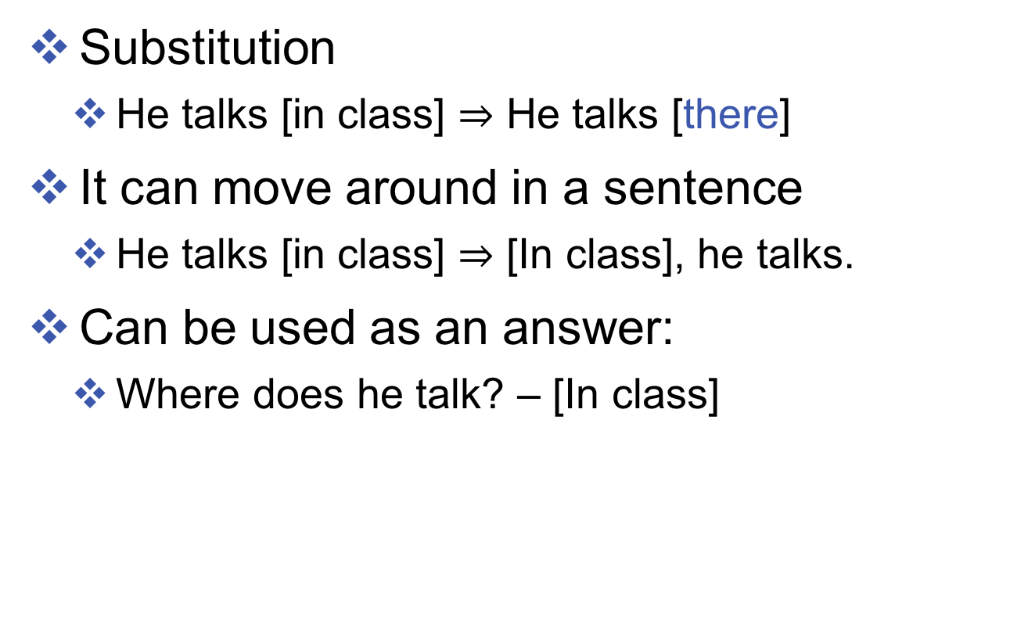
Properties of constituents
Substitution
He talks [in class] $⇒$ He talks [there]
It can move around in a sentence
He talks [in class] $⇒$ [In class], he talks.
Can be used as an answer:
Where does he talk? – [In class]

Slide 17
Types of dependencies
Phrases has a head:
Other parts called dependents
E.g, the man, a girl with glasses
Dependents can be arguments or adjuncts
Arguments are obligatory
E.g., [John] likes [Mary]
Adjuncts are optional
E.g., John runs [fast]
Adverbs, PPs, Adjectives…
All arguments have to be present and cannot be occupied multiple times
Can be an arbitrary number of adjuncts

Slide 18
How to represent the structure

Slide 19
Dependency Trees
Dependency grammar describe the structure of sentences as a graph (tree)
Nodes represent words
Edges represent dependencies

Slide 20
Phrases structure trees
Can be modeled by Context-free grammars

Slide 21
Context-free grammars

Slide 22
Parse tree defined by CFG

Slide 23
Generate sentences by CFG

Slide 24
Example: Noun Phrases

Slide 25
Example: verb phrase

Slide 26
Sentences

